Slide 1
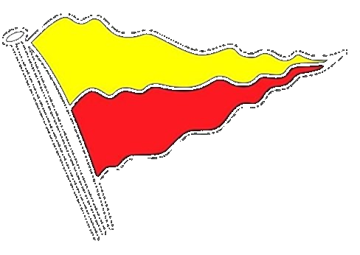
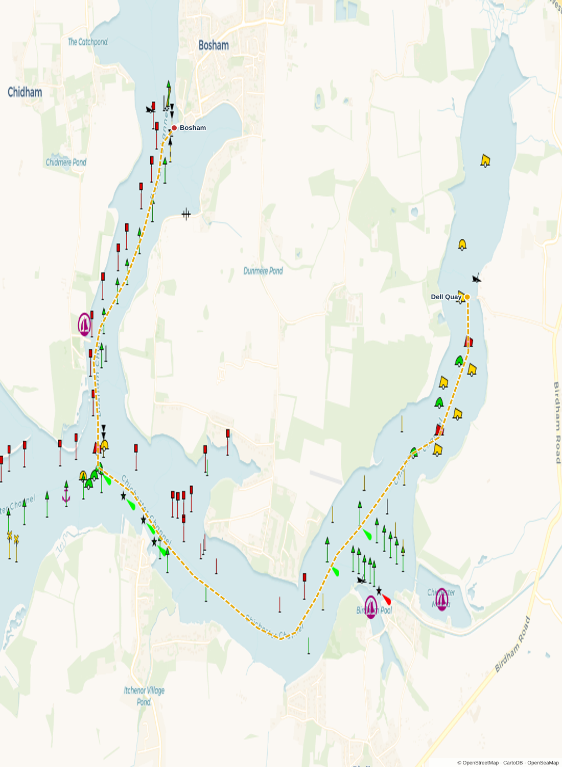
Dell Quay
Sailing Club
Adventure Sailing Handbook
2026
Routes · Briefing notes · Risk · Tides
A guide for Sail Leaders, Patrol Crews and Participants
dellquaysc.co.uk

Slide 2
Aim of DQSC Adventure Sailing
To take dinghy sailors out of the racing arena and onto the wider waters of Chichester Harbour and the Solent — in good company, with proper support, and with the confidence that comes from a well-planned passage.
Build confidence
Sail together
Explore the harbour
Take the skills learned on club nights and apply them in real wind, real tide, and over real distance. Each trip stretches a sailor a little further.
Adventure Sailing is a group activity. We sail as a fleet, between two patrol boats, with a Sail Leader who knows the plan and the people.
Chichester Harbour has five realistic destinations within an afternoon's sail of Dell Quay. The 2026 calendar visits the best of them.
“Get out there. Come back smiling.”
Dell Quay Sailing Club · Adventure Sailing Handbook 2026
2

Slide 3
Adventure Sailing is not Racing
Adventure Sailing has a different rhythm to club racing. Knowing the difference helps everyone — racers and adventurers alike — to enjoy what each format offers.
 | Adventure Sailing | Club Racing
Goal | Reach a destination as a group | Round the marks first
Pace | Set by the slowest boat | As fast as you can sail
Patrol boats | Two — ahead and astern | One — central
Sailors | All abilities, including under-17 with adult | Helms confident in the conditions
Course | Set by the Sail Leader's passage plan | Fixed, set by Race Officer
Bookings | One week ahead via the DQSC website | Turn up and sign on
Briefing | Mandatory — no briefing, no sail | Standard pre-race briefing
Adventure Sailing
Club Racing
Kit checklist
Always bring
Buoyancy aid (worn, not stowed)
Waterproof jacket and salopettes
Hat, gloves, sunscreen
Drinking water and snacks
Whistle attached to BA
Worth thinking about
VHF handheld (Sail Leader carries one)
Spare warm layer in dry bag
Sun glasses with retainer
Lunch box — rides in the patrol RIB
Dell Quay Sailing Club · Adventure Sailing Handbook 2026
3

Slide 4
How we run a trip — SOP key points
Each trip is led by a designated Sail Leader who runs the planning, the briefing and the on-water decisions. A club patrol boat — typically the RIB — accompanies the fleet, in VHF contact with the Sail Leader.
Dinghy Cruising Coordinator
Patrol boat
Participants
Selects the route and writes the passage plan
Completes the Risk Assessment
Confirms patrol-boat launch and haul-out times against the Dell Quay tide window
Briefs participants before launch
Lodges the plan with Shore Support
Calls Shore Support at departure / arrival / departure / return
Holds the handheld VHF in the lead dinghy
Accompanies the fleet, repositioning as conditions require
In VHF contact with the Sail Leader on the briefed channel
Not a training boat — sailors keep their own boat safe
Helps at launch and recovery
Book one week ahead via the DQSC website
Attend the briefing — no briefing, no sail
Sign the on-the-day attendance sheet / whiteboard
Helms responsible for own boat and crew at all times
Stay with the fleet — loop back if you sail ahead of the patrol boat
Under-17s must be accompanied by a responsible adult
Dell Quay Sailing Club · Adventure Sailing Handbook 2026
4

Slide 5
RYA Guidance — patrol boat ratios
The RYA does not set a single dinghy-to-patrol-boat ratio. Instead it gives separate guidance for training, racing and cruising in company — DQSC applies its own cruising-in-company standard.
RYA Training
RYA Racing
DQSC standard
1 : 6
1 : 12
1 boat
One safety boat per six dinghies — applies to coached sessions and on-water training where the safety boat is actively supervising.
One safety boat per twelve racing dinghies — applies during organised club racing where boats are actively competing.
Cruising in company: a single patrol boat accompanies every Adventure Sail, in VHF contact with the Sail Leader. The Sail Leader paces the fleet so all boats stay within sight and supportable range.
Source: RYA Safety Boat Handbook (current edition) — guidance only, club judgement applies on the day.
Dell Quay Sailing Club · Adventure Sailing Handbook 2026
5

Slide 6
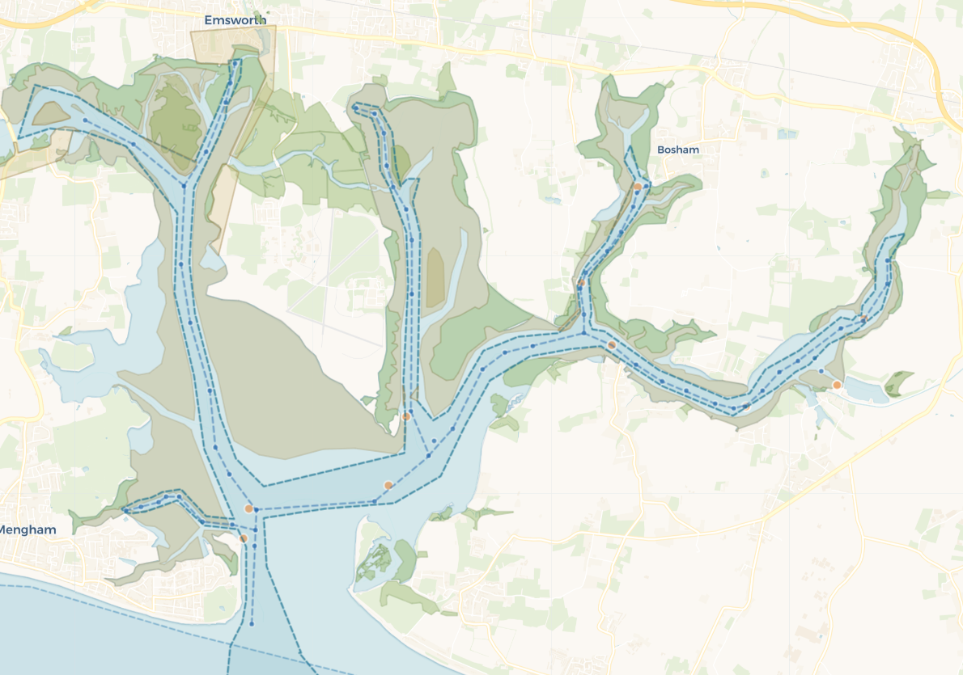
Four destinations from Dell Quay
Adventure Sailing destinations within Chichester Harbour, ordered by distance from Dell Quay. The map shows their positions on the chart.
1 | Chichester Yacht Club | Beginner
2 | Itchenor | Beginner
3 | Cobnor | Beginner
4 | Bosham | Intermediate
5 | East Head | Intermediate
4
3
2
1
5
CHICHESTER HARBOUR · 8 KNOT SPEED LIMIT
Dell Quay Sailing Club · Adventure Sailing Handbook 2026
7

Slide 7
Adventure Destinations
Destination | Departure window | Type | Tide notes
CYC | Any HW | Day sail | Tides any state — short passage
Itchenor | HW -1 | Day sail | Spring tides — strong currents
Cobnor | N/A | Camping | Tides any state — short passage
Bosham | HW -2.5 | Day sail | Very tight schedule. Requires sailing into the tide both ways and getting back just in time to have enough water for haul out. Should only be done with >10kn. Need to plan in to detour to Itchenor instead if behind schedule
East Head | HW +1.5 to 2.5hr | Day sail | Summer trip — high pressure window
All dates subject to weather call by 1800 the day before · Sail Leader confirms patrol-boat launch and haul-out times against the Dell Quay tide window — the slipway dries fully at LW, so timings are tide-driven.
Dell Quay Sailing Club · Adventure Sailing Handbook 2026
6

Slide 8
Destinations summary
# | Destination | Miles (both ways) | Lunch Duration | Trip Duration including lunch | Best Wind | Worst Wind | Level
1 | CYC | 2.8 nm | 1 hr | 2 hr | W, SW | E (beat home) | Beginner
2 | Itchenor | 4.7 nm | 1 hr | 3hr 20min | W, SW | E (beat home) | Beginner
3 | Cobnor Daytrip Cobnor Camp | 6.2 nm | N/A | 4hr | Any | NE chill | Beginner
4 | Bosham | 7.9 nm | 30 min max | 5hr 30min | E | W | Intermediate
5 | East Head | 9.5 nm | 4 hours | 7hr | S N | E W | Intermediate
Distances are actual sailed distance with tacking which can be 1.5×–2× more than the direct line.
Dell Quay Sailing Club · Adventure Sailing Handbook 2026
8

Slide 9
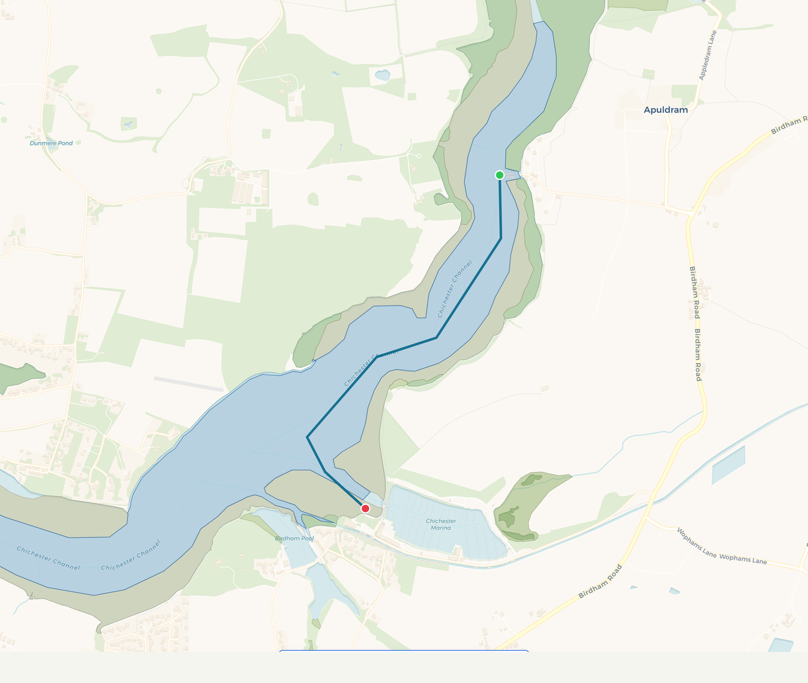
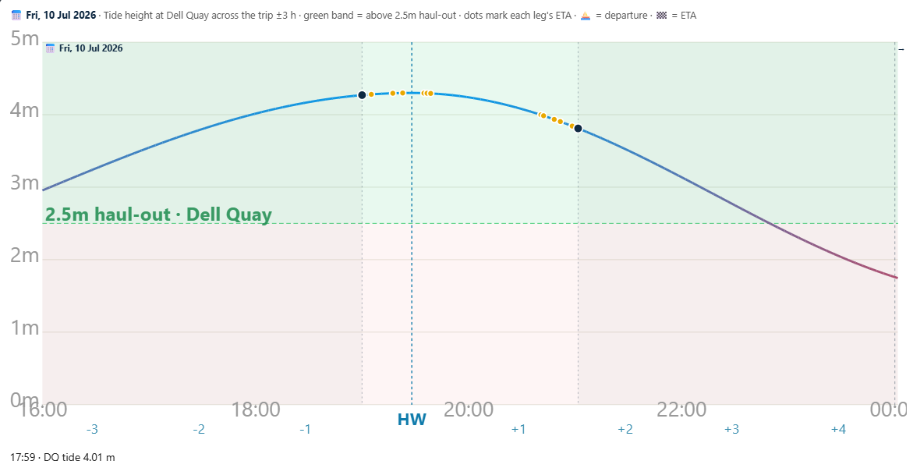
1. Chichester Yacht Club
Bad-weather bolt-hole — a sheltered marina a short hop from home
Beginner / Bad-weather
Distance
2.8 nm total
Avg time
2hr 20min including 1 hr lunch
Best wind
Any — sheltered approach down-channel
Depart
Any state · no HW constraint (sheltered marina)
Hazards
Marina traffic · keep clear of the lock & fairway · speed limit
launch
lunch
Haul PB
Sail Leader note
<2.5m tide
The bad-weather bolt-hole. When the forecast turns, Chichester Yacht Club at Chichester Marina is a short, well-sheltered hop down the channel from Dell Quay. Visitor berths, bar with bear garden, café and facilities ashore. Keep clear of the lock entrance and fairway.
Dell Quay Sailing Club · Adventure Sailing Handbook 2026
13

Slide 10
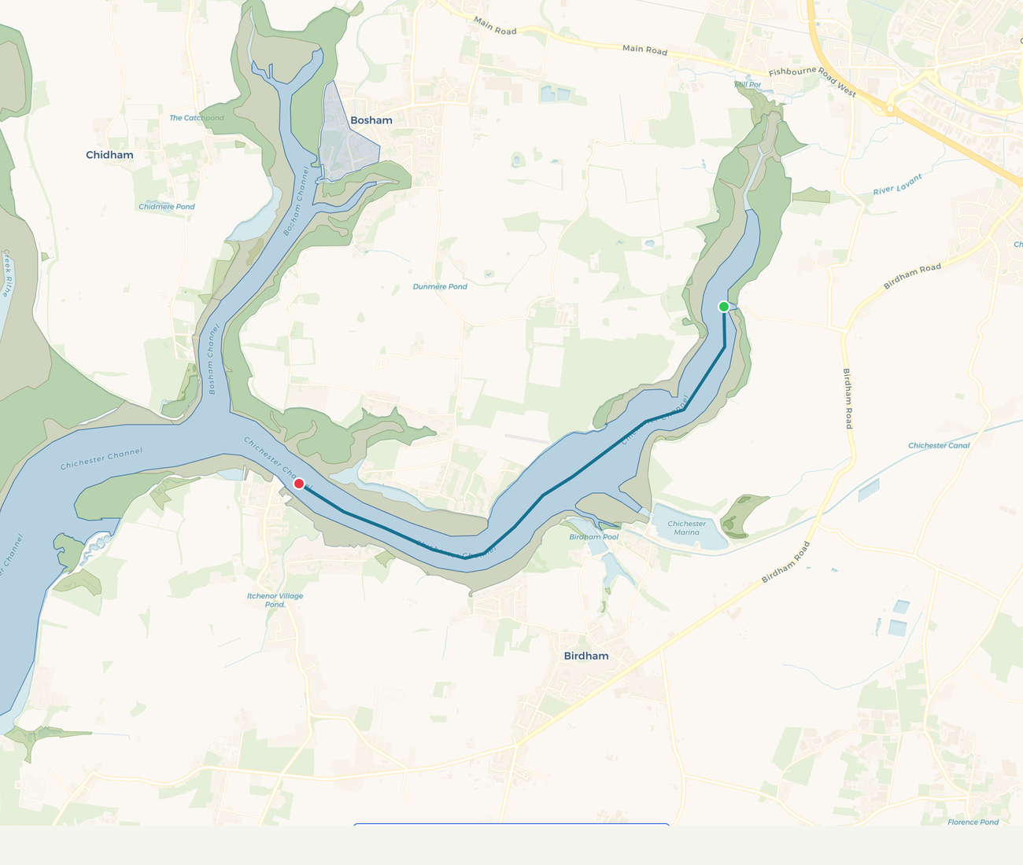
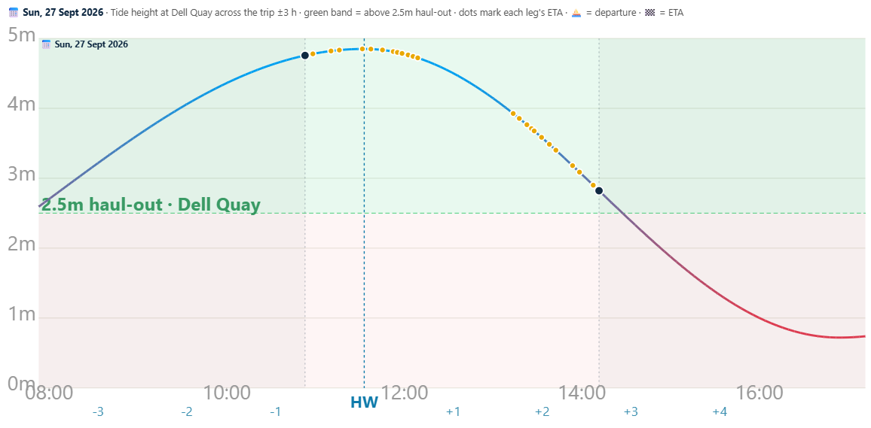
2. Itchenor
Strong tide, sheltered moorings, lots to watch
Beginner
Distance
4.7 nm total
Avg time
3 hr 20 min total including 1hr lunch
Best wind
W, SW (reach down-channel)
Depart
≈ HW −1:00 · strong currents either way, any state
Hazards
Itchenor Reach tide rip · busy yacht moorings
Sail Leader note
Tide does the work in Itchenor Reach — plan the return to avoid a foul tide on the way home.
Dell Quay Sailing Club · Adventure Sailing Handbook 2026
11

Slide 11
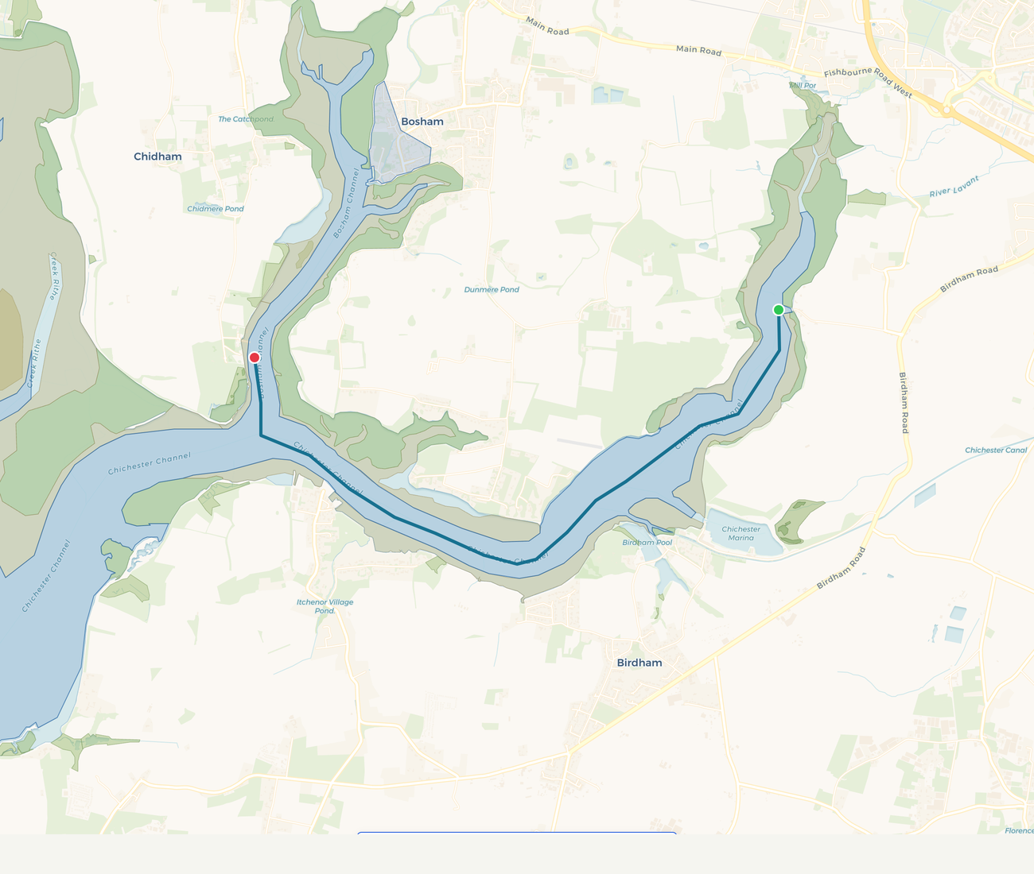
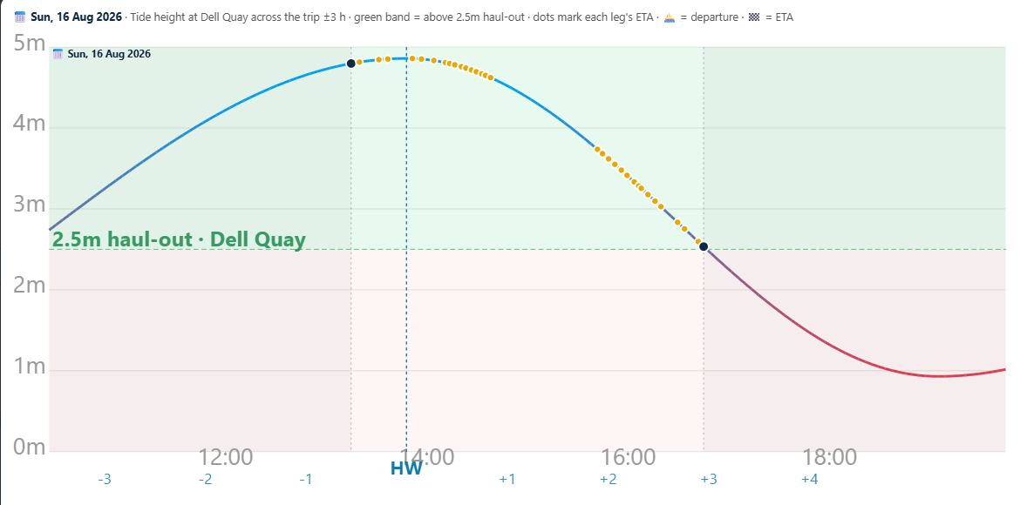
3. Cobnor
A 30-minute sail with a beach lunch
Beginner
Distance
6.2 nm total
Avg time
~4 hr including 1 hr lunch
Best wind
Any — sheltered by Chidham
Depart
≈ HW −0:30 · channel dries on big springs, stay east of beacons
Hazards
Cobnor sandbank south-west · oyster beds (no anchoring)
Sail Leader note
Sandy beach at the point makes for an easy lunch stop. Host of the DQSC summer camp 10–12 July.
Dell Quay Sailing Club · Adventure Sailing Handbook 2026
9

Slide 12
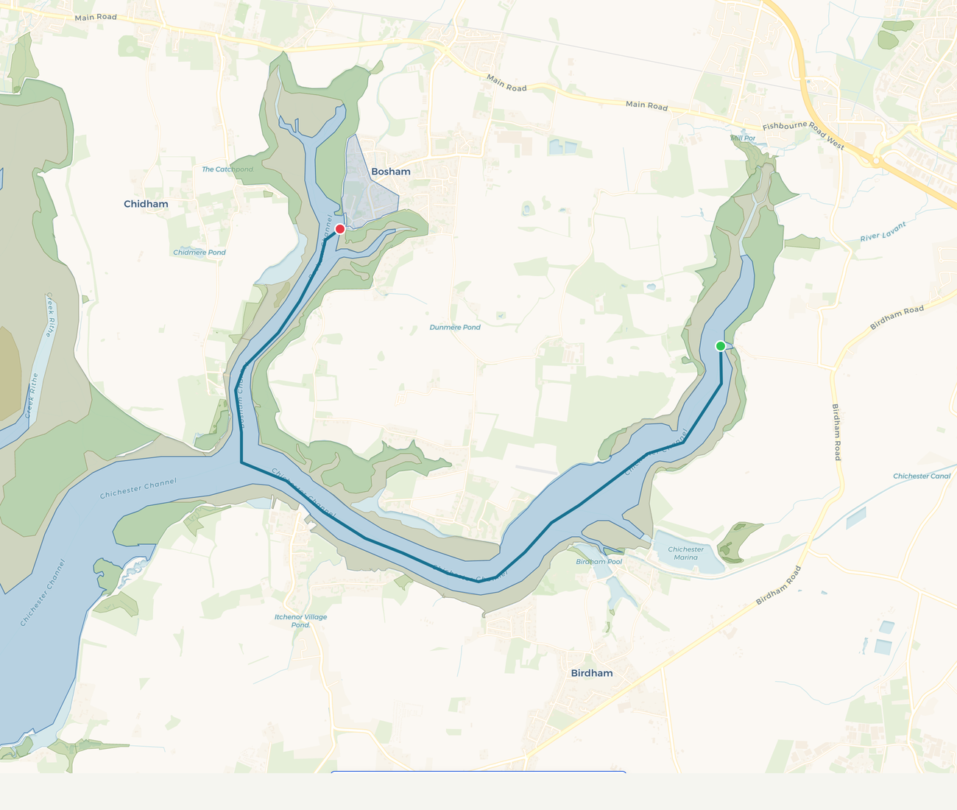
4. Bosham
Picture-postcard village at the head of the channel
Intermediate
Distance
7.9 nm each way
Avg time
5hr 30 min total including 30min lunch
Best wind
W or SW best — reach both ways
Depart
≈ HW −2:30 · land near HW
Hazards
Drying channel beyond Cobnor · road that floods at HW
Getting back late and having insufficient tide to haul out. Use PB tow as necessary to get back in time.
Sail Leader note
Hard tack into the tide. Make sure you have a tow rope
You Manor of Bosham requires a launching fee of £15 “Visitors* welcome for short stays £15 around high tide“ , however, the arrival time is >1hr after high tide.
Dell Quay Sailing Club · Adventure Sailing Handbook 2026
10

Slide 13
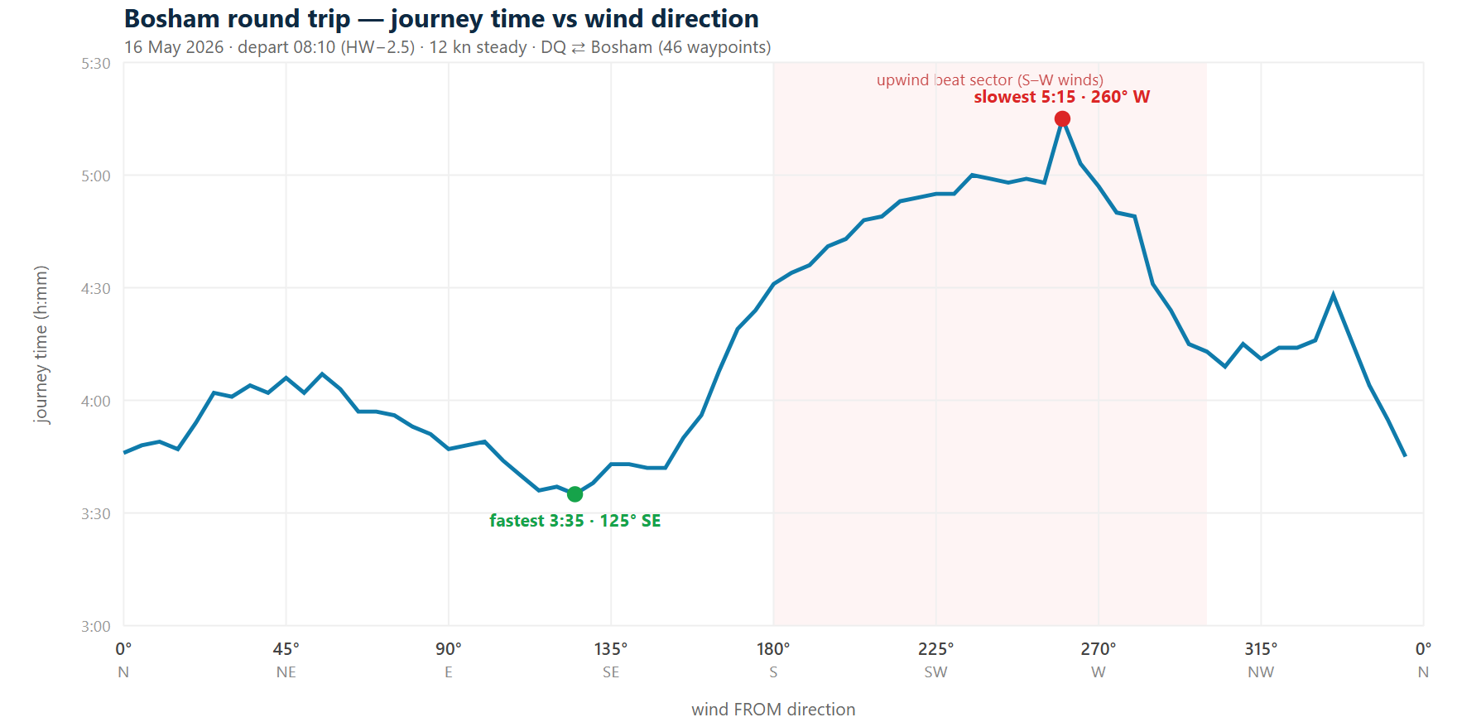
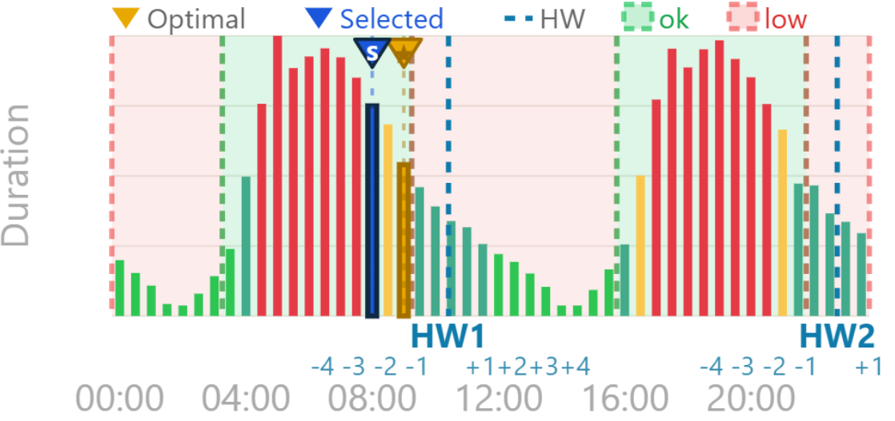
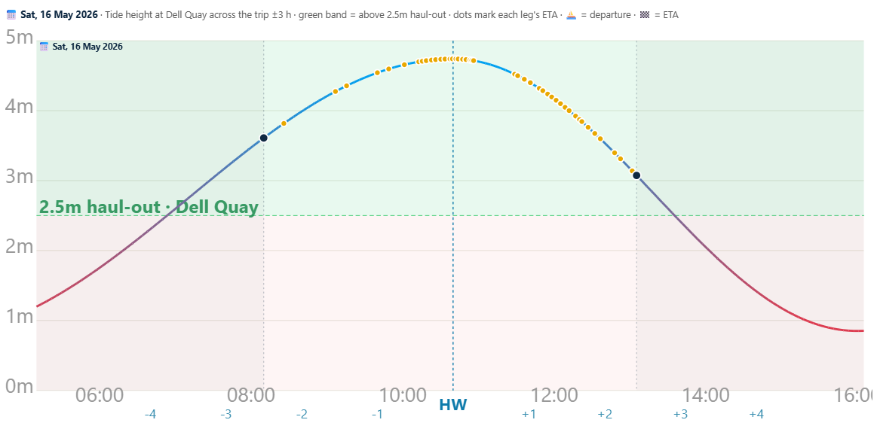
4. Bosham… cont
Keep checking your watch so that you don’t run out of tide
Intermediate
The optimal leave time for shortest journey time (HW-1.5) is also on the edge of the haul out window – meaning, if you leave earlier you are sailing against the tide more and if you leave later, you risk not being able to haul out the PB due to insufficient tide. Leaving HW-2.5hr is safer.
The journey time is ~5hrs with S, W and ~4hrs NW N NE E SE
+1hr extra
Departure time window that allows haul out
OK = enough tide upon return to haul PB out
launch
lunch
Haul
<2.5m tide
+1hr
4hrs

Slide 14
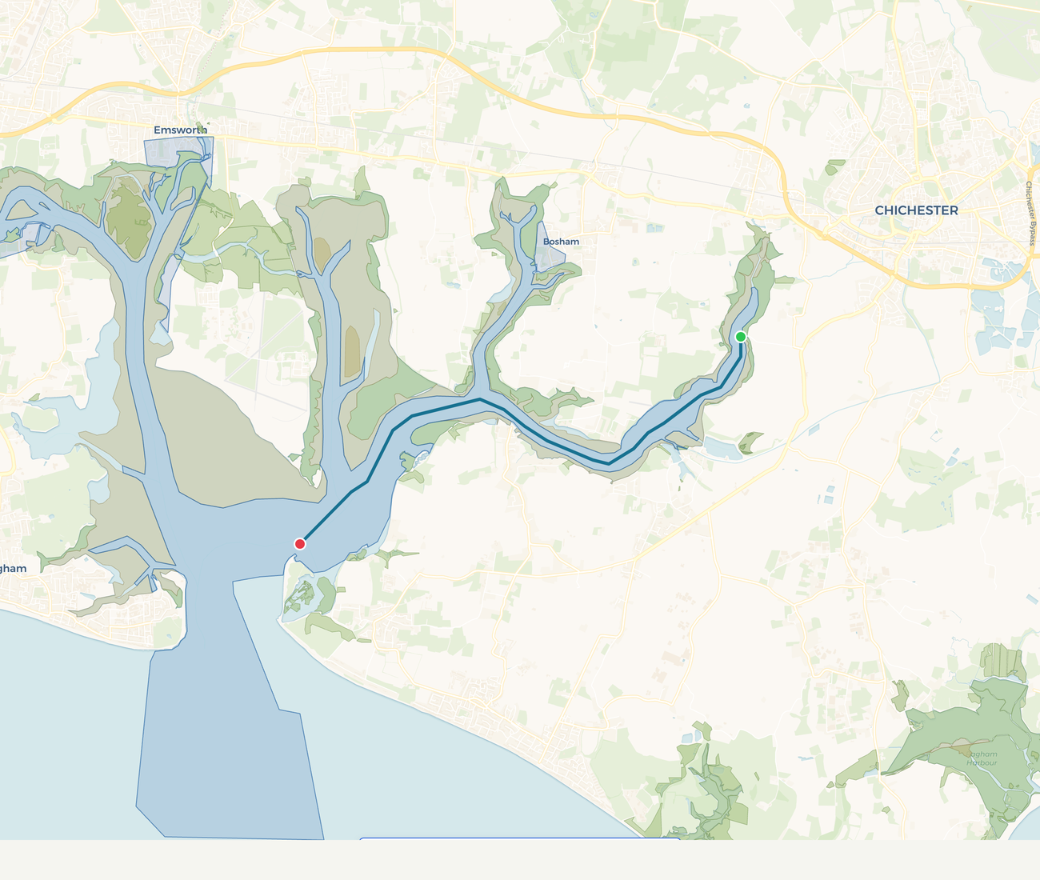
5. East Head
White sand spit at the harbour entrance
Intermediate
Distance
9.5nm total, 4.7 nm each way
Avg time
~1 hr 20 each way. 7hrs total
Best wind
SE to SW — reach there and back
Depart
≈ HW between +1.5 and +2.5hr (ride the ebb out)
Hazards
Collision with yachts , harbour entrance traffic
Sail Leader note
The classic harbour-entrance destination. Two trips in the 2026 calendar (26 Apr spring and 9 Aug summer). Land on the south-east side of the spit.
Dell Quay Sailing Club · Adventure Sailing Handbook 2026
12

Slide 15
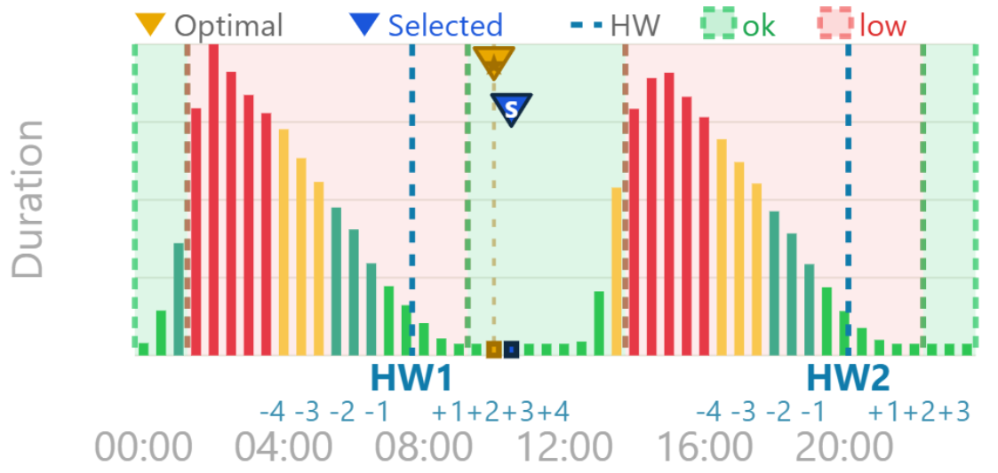
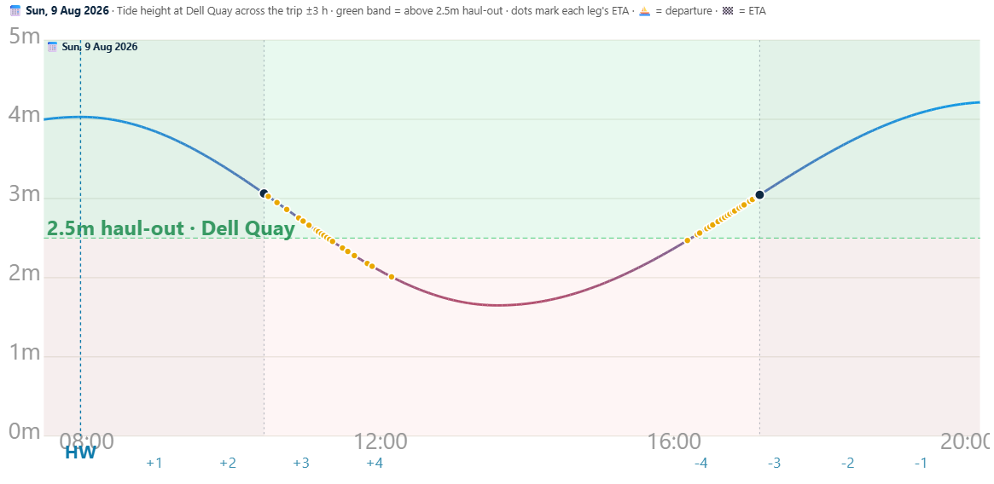
5. East Head… cont
Keep checking your watch so that you don’t run out of tide
Intermediate
The DQ departure window is large. Just need to get the PB launched. The return to base needs to be timed to get enough tide at DQ for PB haul out. The CYC club’s dinghy pontoon won’t be afloat at low tide and the Marina don’t like dinghies on their yacht pontoon. Better to wait at East Head for tide to rise before returning.
The journey time is about is between 6.4hrs and 7.2hrs
+1hr extra
Broad departure time window
OK = enough tide upon return to haul PB out
launch
lunch
Haul
<2.5m tide

Slide 16
Forms, guidance & local contacts
Forms & guidance
Local contacts
Risk Assessment template
Sail Leaders — completed before launch
Chichester Harbour Master
01243 512301 · VHF Ch 14
On-the-day attendance sheet
Sign on at the briefing, DQSC white board
Itchenor Harbour Office
01243 512573 · VHF Ch 14
Solent Coastguard
023 9255 2100 · VHF Ch 16
Sailability (DQSC)
Through club office
HM Coastguard (emergency)
999 — ask for Coastguard
DQSC Bosun
Via the club website
DQSC Shore Support (duty)
Confirmed at the briefing
Bosham Sailing Club
01243 572341
Incident report form
Within 48 hours of any incident
Dell Quay Sailing Club · Adventure Sailing Handbook 2026
14

